Slide 1
SALES DATASET ANALYSIS
Name: SRIDHAR. P
Date:17-03-2025
Course: DADS
Batch: Feb

Slide 2
Project Overview & Objectives
Identify Top-Selling Products: Analyze the best-performing products, examine
their sales trends, and understand the key factors driving their success.
Analyze Sales Dynamics: Investigate the relationships between top-selling products, sales channels,
discounts, and other relevant variables to gain deeper insights into overall sales performance.
Evaluate Low-Performing Products: Identify the least-selling products, assess the reasons for
their poor performance, and develop strategies to boost their sales.
Deliver Actionable Insights: Provide practical recommendations to enhance sales performance,
identify areas for improvement, and leverage growth opportunities.
Row Labels | Sum of Adjusted_sales
Qtr1 | 444655.064
Qtr2 | 394939.7071
Qtr3 | 528527.736
Qtr4 | 606299.2584
Grand Total | 1974421.766
Row Labels | Sum of Adjusted_sales
2014 | 406493.7423
2015 | 407671.3237
2016 | 528294.0311
2017 | 631962.6685
Grand Total | 1974421.766

Slide 3
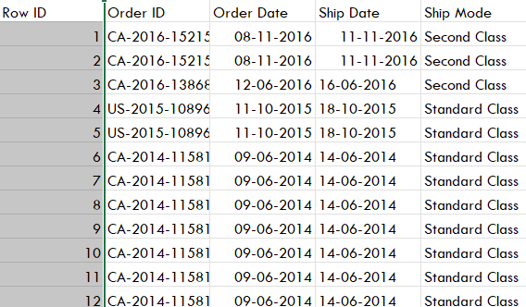
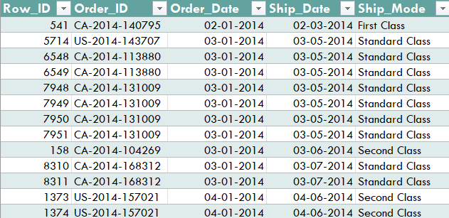
Data Description and Preparation
Dataset Overview:It is a sales data set of superstores it contains 9995 rows and 21 columns
Data Cleaning Process: used power query editor for formatting and sorting the date to ascending orders
GOALS:

Slide 4
Key Metrics Calculation and Data Analysis
Calculations:
Gross Sales | =SUM(Sales Amount)
Net Sales | =Sales-(Discount*sales)
Average Sales | =Average(sales)
Discounted Sale | =(Sales rate*Discount rate)
Month () | =MONTH(orderdate column)
Year() | =Year(orderdate column)

Slide 5
Pivot Tables and Pivot Charts
Row Labels | Sum of Adjusted_sales
Furniture | 618286
Office Supplies | 642642
Technology | 713493
Grand Total | 1974421.766
Row Labels | Sum of Adjusted_sales
Jan | 142632.6259
Feb | 117748.8708
Mar | 184273.5674
Apr | 122846.7527
May | 146446.3224
Jun | 125646.632
Jul | 135782.8367
Aug | 176595.9273
Sep | 216148.9719
Oct | 157000.1477
Nov | 232927.4267
Dec | 216371.684
Grand Total | 1974421.766

Slide 6
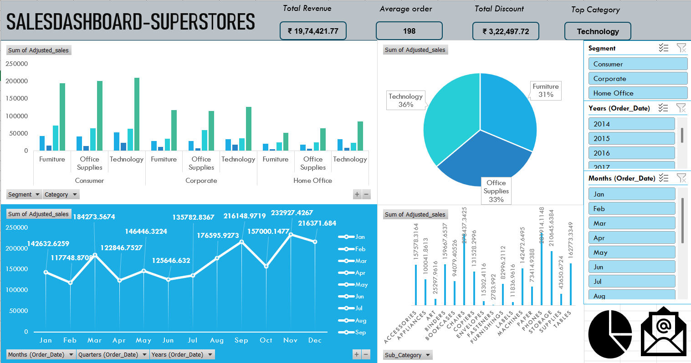
Dashboard Overview
A dashboard is a visual representation of data that provides an at-a-glance view of key performance indicators (KPIs),
trends, and insights. Its purpose is to make complex data more accessible, interactive, and actionable.

Slide 7
What if analysis ,Goal seek& scenario Manager
What-If Analysis: A tool in Excel that allows you to explore how changing input values affects the results of formulas. It helps in decision-making by testing different scenarios. Common methods include Data Tables, Goal Seek, and Scenario Manager.
Goal Seek: A feature used to find the input value needed to achieve a specific goal or result. For example, it can determine the required sales figure to reach a target profit. It works backward by adjusting one variable to meet a desired outcome.
 |  |  | Goal seek
Total Adjusted sales | 1974421.77 |  | ₹ 25,00,000
Average order | 197.58 |  | 197.58
Total Revenue | 2296919.488 |  | ₹ 22,96,919
Total Discount | 322497.7227 |  | ₹ 3,22,498
Total quantity | 37871 |  | 48076.92308
UNIT PRICE | 52 |  | 52

Slide 8
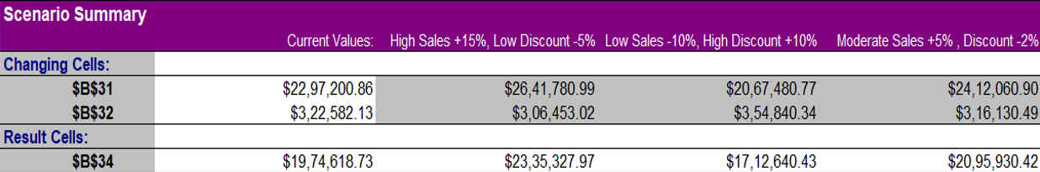
What if analysis ,Goal seek& scenario Manager
III.Scenario Manager: Allows you to create and compare multiple scenarios by changing input values. You can save different sets of inputs (e.g., best-case, worst-case, and most-likely scenarios) and switch between them to see how they impact the results.

Slide 9
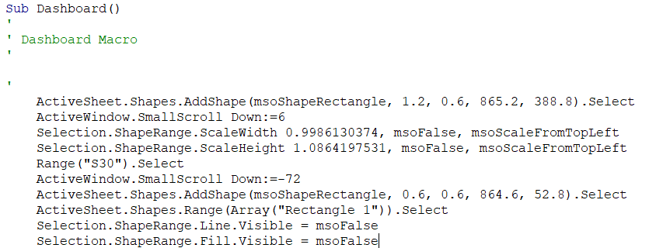
Macros and Automation
Macro recordings:Macro recording is the process of capturing a series of Excel actions (e.g., formatting, data entry, calculations) and saving them as a macro. The macro can then be executed to repeat those actions automatically.
Macro Automation: Macros allow you to automate repetitive tasks, such as data entry, formatting, and calculations, saving you hours of manual work.
Visuals:

Slide 10
Insights and Recommendations
Insights:
Sales Performance by Region:
West -$ 632,051, East -$ 583,976, Central -$ 423,452 & South -334,943.
The West region also led in terms of quantity sold, with 12,266 units, indicating strong customer demand in this region.
Sales Performance by Category:
Technology -$713,493 ,Office Supplies -$ 642,642 & Furniture -$618,286 .
Despite having the lowest sales, Furniture had the highest quantity sold (8,026 units), suggesting lower average prices compared to other categories.
Regional Contribution by Category:
Technology sales were strongest in the East region (230,148), followed by the West (215,153).
Furniture sales were highest in the West region (212,765), while Office Supplies performed consistently across all regions, with the East region leading (184,268).
Quantity Sold by Category and Region:
Office Supplies had the highest quantity sold (22,906 units), with the West region contributing the most (7,235 units).
Technology had the lowest quantity sold (6,939 units), despite generating the highest sales, indicating higher average prices for technology products.

Slide 11
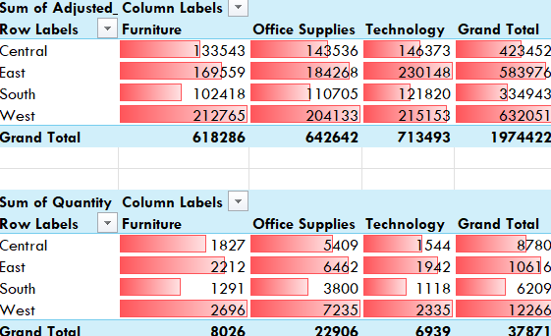
Visuals

Slide 12
Conclusion
The data highlights the importance of the Technology category and the West region in driving overall sales. By focusing on high-performing areas and addressing underperforming segments, there is significant potential to optimize revenue and market share.
Next steps:
Seasonal Sales Analysis
Customer Segmentation
Customer Feedback and Satisfaction
Cross-Selling and Upselling Opportunities

Slide 13
THANK YOU
ANY QUESTIONS?

